Slide 1
The Architecture of a Healthy Portfolio
Turning Raw Bank data into executive ready insight
Notes:
Hello, my name is Stephanie Dues, and today I’m sharing The Architecture of a Healthy Portfolio: Turning Raw Bank Data into Executive‑Ready Insight. I work for a mid‑sized community commercial lending bank in Oregon, and I’m building an analytical framework our institution can rely on as we move toward a more data‑driven model. For this project, I used single‑point, anonymized operational data to show how raw system extracts can be shaped into meaningful, decision‑ready intelligence.

Slide 2

Intent & Direction
The objective of this project is to build a scalable, executive-ready framework for assessing portfolio health using single point data. It also outlines enhancements required to support future trend analysis and deeper relationship insights.
Notes:
The purpose of this work is simple: to create a scalable, reliable way to assess portfolio health using the data we already have. What I’ll walk through are the things that can be measured confidently today, where our current data limits deeper analysis, and how this framework lays the groundwork for a modern reporting structure that can grow with the bank’s needs.

Slide 3
Healthy Portfolio Overview
Balanced Credit Exposure
Loan concentrations aligned with risk appetite and regulatory expectations
Sustainable Relationship Profitability
Returns that justify capital, servicing, and risk
Predictable Cash Flow Performance
Repayment patterns that support long – term stability
Diversified Portfolio Mix
No outsized exposure to a single borrower, industry, or collateral type
Consistent Credit Quality
Stable risk grades, low delinquency, minimal expectations
Strong Core Deposit Base
Stable, low – volatility funding supporting loan growth
Notes:
When we think of a healthy portfolio we look for one that shows balance, resilience, and long‑term stability. You find that in diversified credit exposure, a balanced product and collateral mix, consistent credit quality, and low delinquency. You also see it in a stable deposit base, sustainable relationship profitability, and predictable cash‑flow behavior. When these elements work together, they tell us not only how the portfolio is performing right now, but how well it’s positioned to stay stable as conditions shift.

Slide 4
Healthy Borrower Lender Relationship
Deposit – Loan Balance Alignment
Deposits that meaningfully offset credit exposure
Stable Risk Rating
No recent downgrades or emerging credit concerns
Relationship Profitability
Spreads, fees, and services that meet profitability targets
Clean payment Behavior
Transparent Communication
Borrower responsiveness and proactive financial updates
On time payments, low volatility, no recurring exceptions
Engagement & Activity
Active accounts, treasury services, and consistent deposit flows
Notes:
However, portfolio health always comes back to the strength of each individual relationship. At that level, we look for alignment between deposits and loans, stable risk ratings, and profitability that meets expectations. Beyond the numbers, healthy relationships also show clean payment behavior, active engagement, and transparent communication. When these qualities are present, they signal borrowers who are reliable, responsive, and set up for long‑term success with the bank.

Slide 5
Data Intake & Privacy Integrity
Pulled Live System Data
Extracted directly from the core platform to ensure accuracy and completeness
Manual Reviewed Remaining Fields
Verified and anonymized any data that could not be safely transformed through automation methods
Anonymized Sensitive Information
Applied formula based de-identification for Borrowers, Officers, Branches, and Account Information
Removed Trailing & Leading Spaces
Eliminated whitespace issues that impact validation, joins, filters, and grouping logic
Corrected Data Types
Standardized formats across reports and support clean analysis
Validated all Fields
Checked for correctness, consistency, and alignment with expected business rules
Database Creation
Using completed files, SQLite database was created for analysis within SQL and Jupyter Notebook
Notes:
To support this analysis, I started by defining a clear approach for how each metric would be evaluated. All data was pulled as single‑point extracts from the live core system, where it was first checked for accuracy and consistency. After extraction, I standardized the data, cleaned it, and anonymized every identifying field—first through formula‑based processes, and then through manual review for anything that couldn’t be anonymized automatically. After that, all extracted reports were used to create a database to be queried against.

Slide 6
Core System Extracts
Table 1 - Customer Information
Data Size
Anonymization
Table 2 - Collateral
Data Size
1,408 Rows
Table 3 – Loan Portfolio
Table 4 – Deposit Portfolio
20,426 Rows
8 Columns
Customer Name
Officer
Branch
11 Columns
Anonymization
Loan Number
Data Size
2,381 Rows
1,144 Closed Loans
1,237 Open Loans
Anonymization
Customer Name
Loan Number
Officer
Branch
Data Size
11,762 Rows
62 Columns
Anonymization
Customer Name
Account Number
Officer
Branch
135 Columns
Notes:
Four reports formed the foundation of the dataset: the Customer Information Report, which anchored the anonymization; the Collateral Report; the Loan Portfolio Report, which was reduced by more than a thousand rows which represented closed loans that were not used in this analysis; and the Deposit Portfolio Report. Together, these created a clean, unified dataset for analysis. This analysis was completed completely in a SQLite data base and visualizations were created through Python

Slide 7
Constraints of Single – Point Data
Single Point Data
No Recurring System Access
Limited Behavioral System Access
Incomplete Profitabillity Picture
Static Credit Indicators
Concentration Exposure Boundaries
Analysis reflects one point in time; no ability to observe trends or seasonality
Unable to validate changes, updates, or corrections made after data extraction
Cannot measure borrower activity patterns, deposit volatility, or payment consistency over time
Risk grades, collateral values, and exceptions cannot be trended or monitored for movement
Fee income, treasury usage, and yield contribution cannot be evaluated longitudinally
Snapshot limits the ability to assess emerging concentrations or shifts in portfolio mix
Notes:
As this data is based on a single snapshot, we can evaluate the portfolio at one moment in time, but we can’t observe trends or seasonality. Without recurring system access, we cannot validate updates or corrections, and have a limited visibility into borrower behavior, deposit volatility, or payment consistency. These limitations define what we can measure today and highlight the need for time‑lapse data to support future modeling.

Slide 8
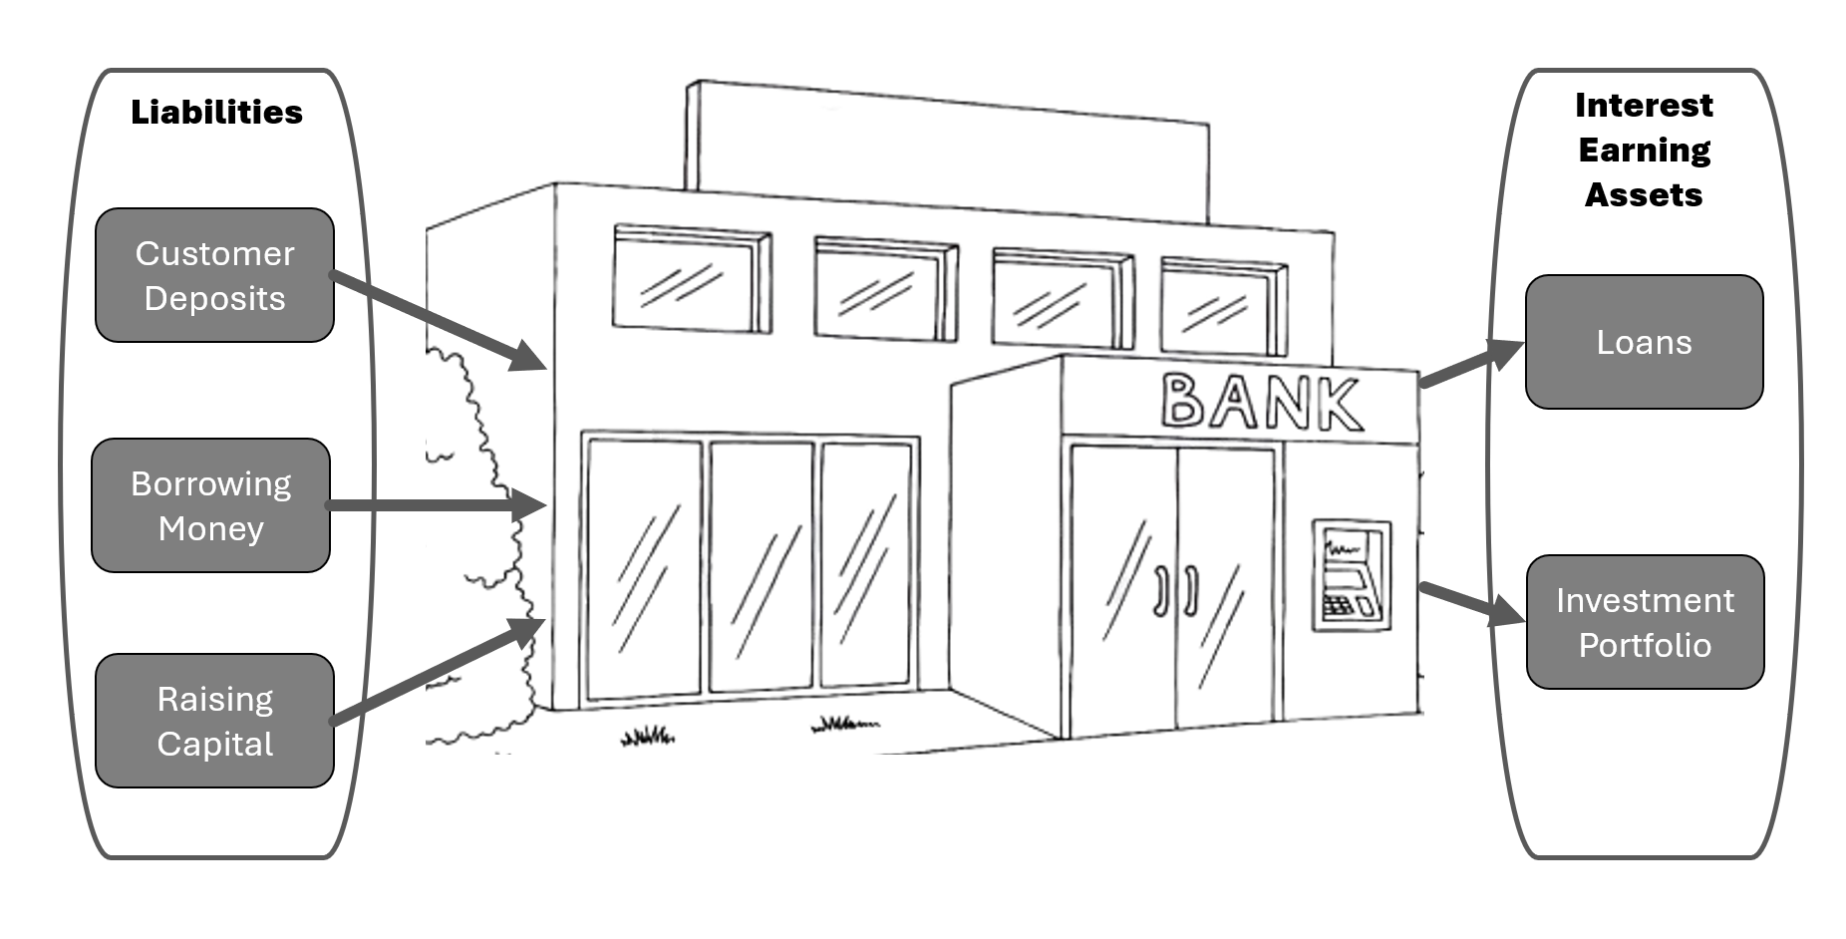
Portfolio Composition
A SNAPSHOT OF EXPOSURE, BALANCES, AND PRODUCT MIX
Notes:
Portfolio composition is central to understanding the health of any financial institution. At its core, it’s the balance between assets and liabilities within each customer relationship. To make that assessment we look at the direction money flows. Assets are accounts that generate income for the bank. When we lend money, the principal we commit—our exposure—is money out the door, and it carries the possibility of not being returned. The interest a borrower pays each month, and any fees associated with open accounts, however, are income and therefore an asset. Liabilities, on the other hand, are accounts that cost the bank money. Deposits held with us require the bank to pay interest back to the customer, which creates an outgoing expense. Understanding this mix—how much we’ve put at risk versus how much we’re paying out—is essential to evaluating the strength of the portfolio and the overall risk posture of the institution.

Slide 9
Loan Exposure and Deposit Balances
Loan exposure
Deposit balances
Total Loans - 1,237
Total Exposure ~ $676.4 million
Average Loan Size ~ $639 thousand
Agriculture Loans ~ $442 thousand
Commercial & Industrial Loans ~$250 thousand
Loans to Individuals ~ $790 thousand
Real Estate Loans ~ $547 thousand
Total Deposit Accounts - 11,763
Total Deposit Balances ~ $485.7 million
Average Deposit Balance ~ $41 thousand
Average Minimum Balance ~ 36 thousand
Notes:
Right now, the institution is managing more than twelve hundred active loans totaling about six hundred seventy‑six million dollars in exposure. The mix spans agriculture, commercial and industrial, consumer, and real estate lending, which helps stabilize earnings and reduce concentration risk. On the deposit side, nearly twelve thousand accounts hold roughly four hundred eighty‑five million dollars. These deposits form the funding base that allows us to lend and directly influence our cost of funds. Together, these two sides give us the foundation for evaluating long‑term sustainability.

Slide 10
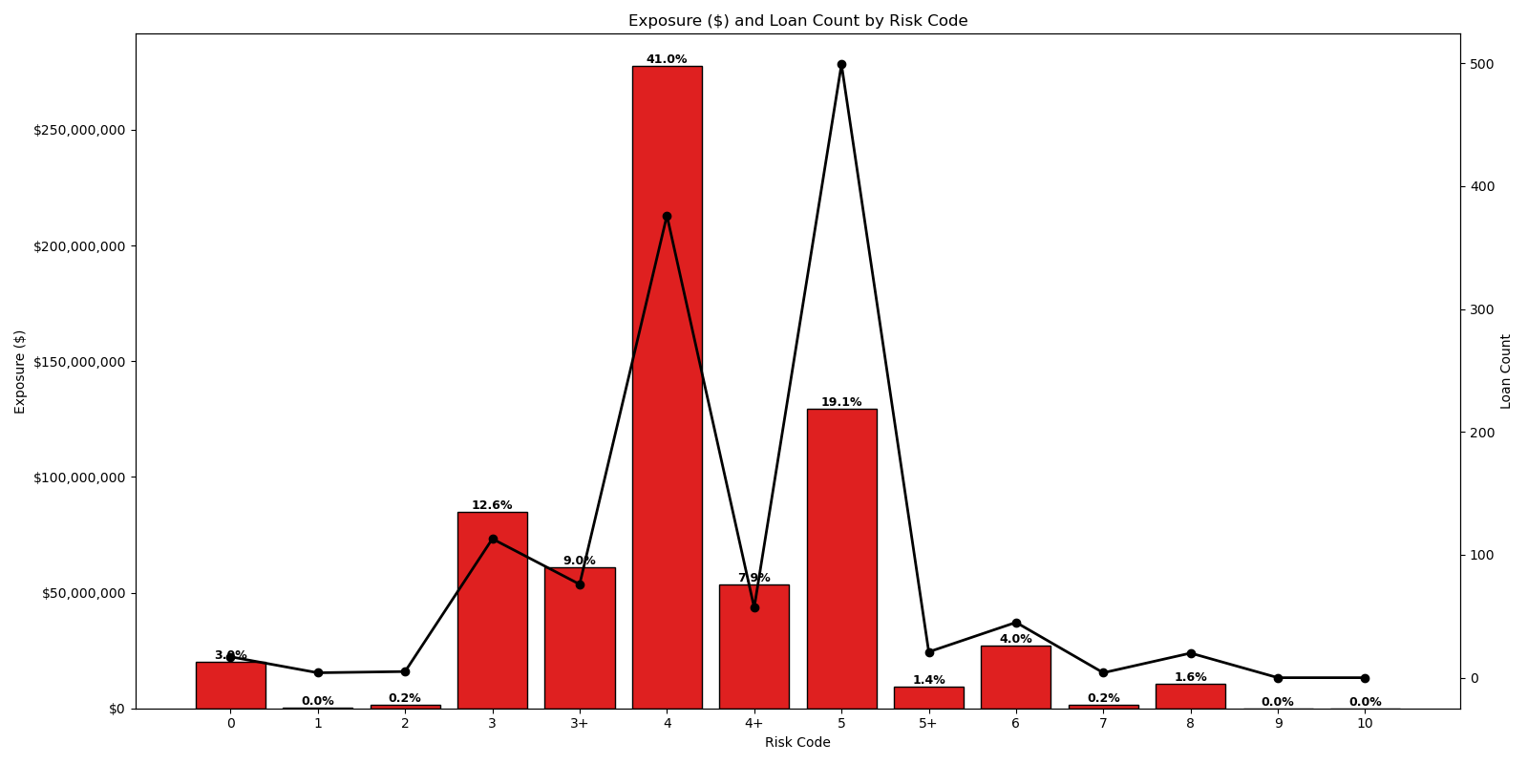
17 loans have no assigned risk rating, which warrants follow-up to ensure accurate portfolio classification
Low quality loans account for $12,026,930 of overall exposure
High Quality / Low Risk Range
Poor Quality Range
Notes:
During a portfolio review, assessing the borrower’s risk profile and the strength of their overall relationship with the bank is essential, because it tells us how much risk the institution carries on any given customer and how that exposure aligns with our broader stability goals. Excessive exposure to a high‑risk borrower increases the likelihood of losses and weakens portfolio resilience, so understanding where each relationship sits on the spectrum matters. In this dataset, the risk distribution forms a rough bell curve centered in the Acceptable Quality grades, which is generally a sign of a healthy portfolio. A small number of loans lack assigned risk ratings and need follow‑up, high‑quality loans make up only a very small portion of exposure, and poor‑quality loans represent less than two percent. The overwhelming majority sits in the middle, indicating a portfolio anchored in stable, moderate‑risk lending with limited exposure at the extremes.

Slide 11
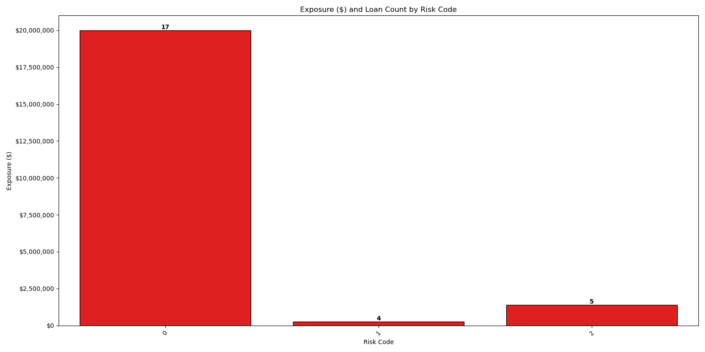
High Quality / Low Risk Range
Notes:
In reviewing the lowest‑risk categories, we note 17 loans with no assigned risk rating, which warrants follow‑up to ensure accurate portfolio classification. However, among these loans that are properly rated within the High‑Quality / Low‑Risk range, there are 9 loans, representing 0.20% of total exposure at $1,625,613.57. If we were to include the loans that are not assigned a risk rating, there are 26 loans, representing 3.20% of total exposure in the amount of $1,645,913.57

Slide 12
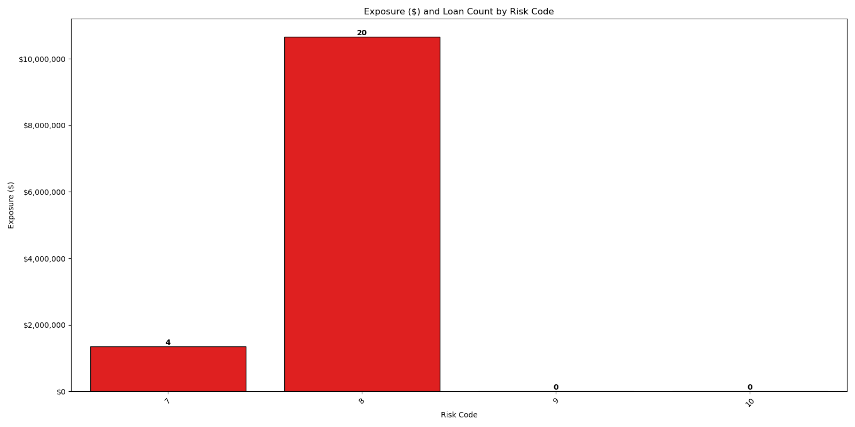
Poor Quality Range
Notes:
Additionally, 24 loans fall within the Poor Quality range, representing 1.8% of total loan exposure in the amount of $12,026,930.33.

Slide 13
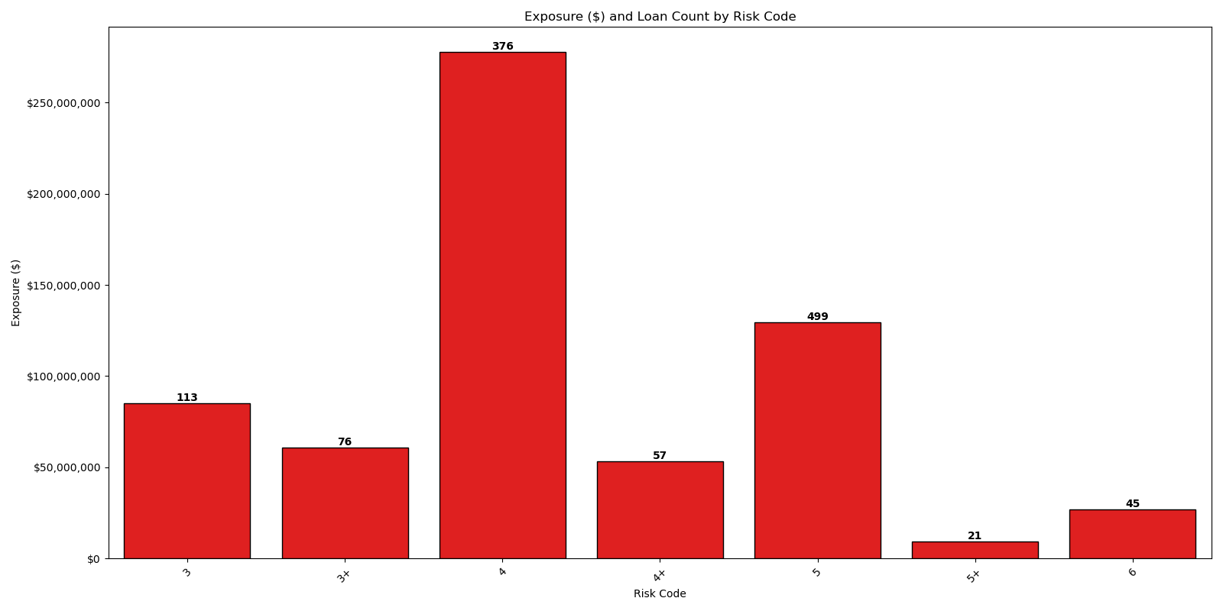
Acceptable Quality Range
Notes:
In comparison, most of the lending portfolio is concentrated in the Acceptable Quality range, with 1,187 loans representing 95% of total exposure in the amount of $642,725,550.21. Taken together, the distribution shows a portfolio anchored in mid‑range, Acceptable Quality risk grades, with limited exposure at the extremes and minimal concentration in Poor Quality loans

Slide 14
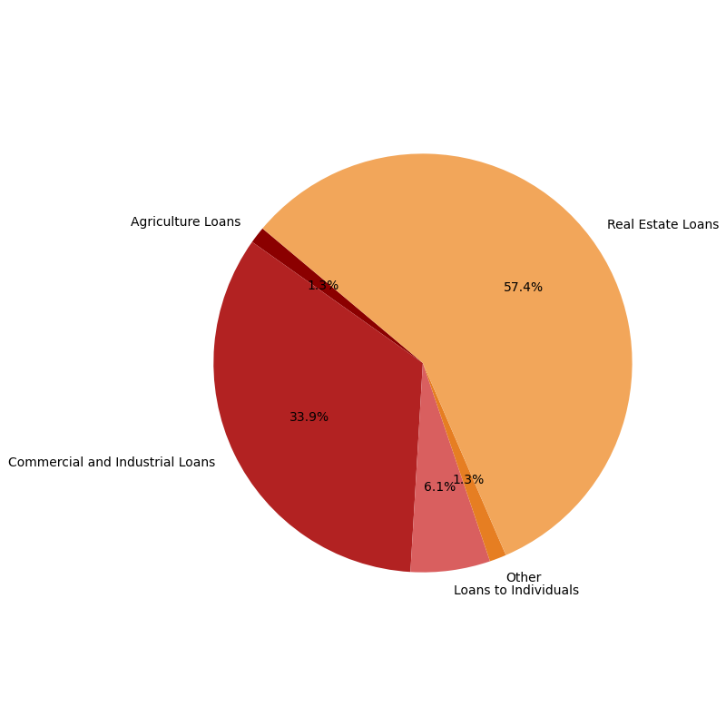
Loan Exposure by Purpose

Slide 15
Collateral Coverage

Slide 16
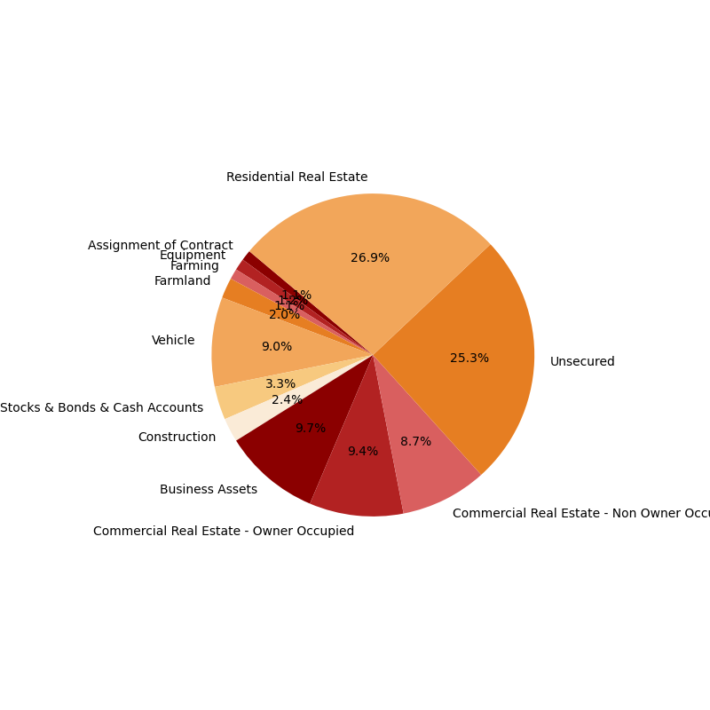
Loan Exposure by Collateral

Slide 17


Total Deposit Fees
Types of Deposit Fees
Fees refunded
Insufficient funds
Returned items
Wire & Bill Pay
Remote deposit
Fraud protection
Stop pay
Cash management services
2025
Total fees refunded - $4,098
2026 through report date
Total NSF fees refunded - $3,479
Total Other fees refunded - $4,653
Total Service Charge fees refunded - $1,341
Total days portfolio overdraft – 957
Total Fees Refunded as of Report Date
$9,474
Notes:
As we look at total fees, not all fees are currently trackable based on the way data was extracted from the system. Looking at fees refunded on the deposit side, we see that we have increased our refunded deposit fee total year over year. This highlights a meaningful shift in customer activity. Last year, we refunded just over $5,000 in trackable total fees. Through the data pull date, that number has increased, across several types of fee types. High refund activity can signal customer friction or opportunities to adjust fee structures, strengthen education, or refine account tools.

Slide 18

Total Loan Fees
Types of Loan Fees
Fees refunded
Loan origination fees
Document preparation fees
Late fees
Prepayment penalty fees
Total late charges paid this year - $6,932
Total late charges waived this year - $4,458
Notes:
On the loan side, there are several types of fees collected through the life of a loan, and together they help us understand where revenue is being generated and where customers may be running into challenges. So far this year, we’ve collected a roughly 7 thousand dollars in late charges, but we’ve also waived roughly half that amount in late charges as well. That balance between what’s paid and what’s refunded offers insight into how consistently borrowers are meeting their obligations and how often we’re stepping in with discretion. Overall, this snapshot helps us balance two priorities: maintaining fair, transparent fee practices while also protecting the institution’s revenue integrity.

Slide 19
Interest Income & Liability
Interest income
Interest liabilities
Total interest accrued this year - $11,608,594
Total interest paid last year - $3,776,803
Total interest paid this year - $888,383
** Net interest income year to date - $10,720,211
* Net interest income calculated from interest accrued YTD and not interest collected YTD.
Notes:
Looking at interest income and liability, the total interest accrued this year reflects the strength and stability of our earning assets. Conversely, last year’s interest paid to this year’s amount helps us understand how funding costs are shifting and how our balance‑sheet mix is evolving. Together, these figures show how effectively we’re managing both sides of the interest equation, balancing revenue generation with the cost of maintaining customer deposits and other funding sources.

Slide 20
Interest Income & Yield
Notes:
Clearly define objective. State findings for next steps or recommendations or insights
Solution oriented ending
End with officer snapshot

Slide 21
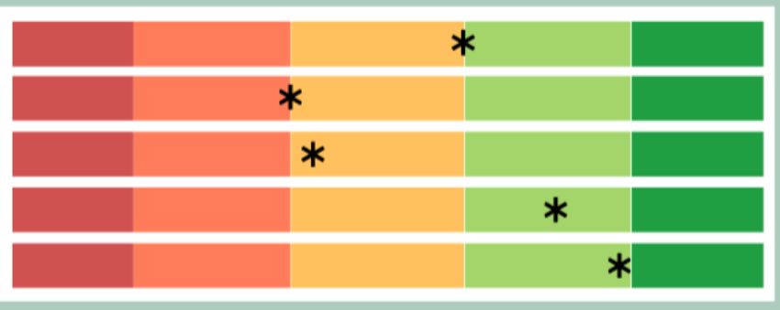
Portfolio Score
Portfolio score
Risk score
Positive Metric
Measures whether an officer maintains a balanced portfolio across core product types
100 – Both loans and deposits present
50 – Either loans or deposits present
0 – Neither loans nor deposits present
Positive Metric
Measures the credit quality of a loan portfolio when loans are present
100 – No delinquency, nonaccrual, or charge off exposure
50 – Mid-range delinquency, nonaccrual, or charge off exposure
0 – High delinquency, nonaccrual, or charge off exposure
Notes:
Once we understand the portfolio as a whole, we can look at how these dynamics appear at the officer level. I have created an officer scorecard that takes four measurements to create an overall portfolio measurement from 1 - 100. The portfolio score looks at whether an officer is maintaining meaningful activity across both loans and deposits, giving us a quick read on relationship depth. The risk score complements that by evaluating the overall credit health of the loans they manage, highlighting how effectively risk is being monitored and controlled. Together, these two metrics create the baseline for understanding an officer’s overall performance, grounding the rest of the scorecard in both activity and asset quality.

Slide 22
Portfolio Score cont.
Deposit score
Ops score
+ Positive Metric +
Measures the strength and stability of an officer’s deposit portfolio
100 – Strong deposit performance with stable balance levels
50 – Mid range deposit performance with average balance levels
0 – Low deposit performance with weak balance levels
Negative Metric
Measures operational discipline in fee – refund behavior
100 – Excellent fee discipline with low or minimal fee refunds
50 – Mixed fee discipline with inconsistent fee refunds
0 – Poor fee discipline with high volume of fee refunds
Notes:
The scorecard expands further when we look at two additional dimensions of officer performance: deposit strength and operational discipline. The deposit score reflects the stability and depth of an officer’s funding base, giving us a sense of how consistently they maintain healthy balance levels across their portfolio. Operational discipline captures the behavioral side—how often fees are being refunded and what that reveals about day‑to‑day decision‑making. Together, these metrics help us understand not just the financial outcomes officers generate, but the operational habits driving those outcomes, creating a more complete and balanced view of performance.

Slide 23
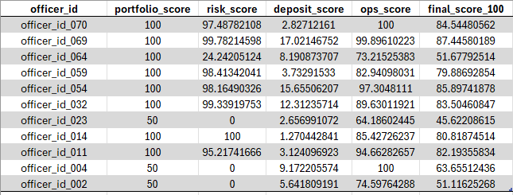
Portfolio Scorecard Metrics
Risk Score – 35%
Deposit Score – 15%
Operations Score – 30%
Portfolio Score – 20%
Deposit Score – 15%
Notes:
Except for the Portfolio Score, all metrics were normalized to create a consistent basis for comparing one officer’s performance against another. This ensures that individual portfolios—each a small part of the institution’s overall book—can be evaluated on an equal footing. After normalization, a final weighted score was calculated using the assigned importance values, providing a balanced and consistent measure of overall performance.

Slide 24
Officer Performance Scorecard
Notes:
With these four performance metrics calculated individually, the final scorecard unifies every dimension of officer effectiveness into a single, coherent view. Together, these measures capture not only outcomes but also the underlying behaviors that shape long‑term relationship management. Each metric highlights a different facet of the officer’s approach, and when viewed collectively, they reveal meaningful patterns: who maintains stable, well‑rounded relationships, who manages risk with discipline, and where operational habits may be strengthening or weakening overall performance.
This consolidated perspective transforms the scorecard from a simple measurement tool into a diagnostic lens. It surfaces standout strengths, pinpoints areas where coaching or support may be needed, and clarifies how individual decisions scale into broader portfolio impact. In doing so, it provides a clearer understanding of the discipline, judgment, and relationship‑building practices that drive sustainable portfolio health.
Looking at a filtered view of the scorecard, the officers shown currently fall between 45% and 87%, indicating meaningful room for improvement. Each portfolio can now be evaluated holistically through the final score and individually through each previously calculated pillar, enabling more precise and consistent performance conversations.

Slide 25
Recommendations
Strengthen Naming Conventions – Ensure consistent, standardized naming across all systems
Validate Physical & Mailing Addresses – Align address fields across platforms
Standardize Fee Waiver Recording – Implement uniform tracking of waived fees across all systems to strengthen operational discipline, reduce discrepancies, and improve visibility into customer-impacting trends
Ongoing Data Accuracy Audits – Implement a recurring review cycle to validate critical data fields across systems, ensuring information remains current, consistent, and reliable for reporting, risk assessment, and operational decision-making
Notes:
From here, the question becomes: what do we do next? Strengthening core data practices—standardizing naming conventions, aligning address information, and creating consistent fee‑waiver tracking will reduces noise, improve reliability, and allows for a broader view of activity. Ongoing accuracy audits will also ensure that the information we rely on stays clean and actionable. These foundational improvements support both performance evaluation and customer‑impact visibility.

Slide 26
Next Steps
Access additional fields for deeper dive
Transaction History
Collateral information
Add additional data points to enable time-lapse trend modeling
Interest income v liabilities
Partial collected and waived fees
Notes:
As we gain access to richer data, this analysis can grow significantly. Adding transaction history, additional collateral details, and time‑lapse trend modeling we can deepen our understanding of portfolio behavior at both the relationship and officer levels. Tracking interest income relative to liabilities, monitoring partialyl collected or waived fees, and modeling changes over time will allow us to identify emerging risks earlier and build a more dynamic, forward‑looking view of performance. Strengthening our core data practices and expanding our analytical capabilities positions the bank for a more modern, scalable reporting architecture. By building clean, consistent, and actionable data foundations today, we create the structure needed for deeper insights, stronger performance evaluation, and a more resilient portfolio tomorrow.

Slide 27
Final Acknowledgement
This end – to – end data insights project was developed by Stephanie Dues in partnership with the Data Analytics Bootcamp at FullStack Academy
The Architecture of a Healthy Portfolio
Stephanie Dues - 2026
https://www.linkedin.com/in/stephaniejdues/
Thank you
Notes:
As we bring everything together, what becomes clear is that strong portfolio management isn’t just about the numbers—it’s about the structure behind them. By building a framework that unifies balance, credit quality, deposit strength, and operational discipline, we’re creating a foundation that supports clearer decisions, stronger relationships, and a more resilient institution. The work we’ve done here shows what becomes possible when clean data, thoughtful design, and consistent evaluation come together. And as we continue expanding our data access and refining our practices, this framework will only grow more powerful. It positions us not just to understand where we stand today, but to anticipate where we’re headed and to guide the portfolio with greater confidence and clarity. Thank you.

